Slide 1
Stacks

Slide 2
Chapter Objectives
To learn about the stack data type and how to use its four methods: push, pop, isfull, and isempty
To learn how to implement a stack using an underlying array or a linked list
To see how to use a stack to perform various applications, including finding palindromes, testing for balanced (properly nested) parentheses, and evaluating arithmetic expressions

Slide 3
Stack
Stack is linear Data Structure with the property that Elements can only be inserted and removed from the top of the collection. Random-access is not defined
The stack’s storage policy is Last-In, First-Out
Main Stack operations are
  Push() - insert an element
  Pop() - removes an element
  Isempty() - returns true if no element in stack
  Isfull () - returns true if elements in stack is equal to stack size

Slide 4
Applications of Stacks
Direct applications
  Page-visited history in a Web browser
  Undo sequence in a text editor
  Saving local variables when one function calls another, and this one calls another, and so on.
Indirect applications
  Component of other data structures

Slide 5
Applications of Stacks
The C run-time system keeps track of the chain of active functions with a stack
When a function is called, the run-time system pushes on the stack a frame containing
  Local variables and return value
  Program counter, keeping track of the statement being executed
When a function returns, its frame is popped from the stack and control is passed to the method on top of the stack
main()
{
int i = 5;
foo(i);
}
foo(int j)‏
{
int k;
k = j+1;
bar(k);
}
bar(int m)‏
{
…
}
bar
PC = 1
m = 6
foo
PC = 3
j = 5
k = 6
main
PC = 2
i = 5

Slide 6
How stack works
tos=1
b
a
a
tos=0
a
tos=0
tos= -1
push(a)‏
push(b)‏
pop(b)‏

Slide 7
Stack Representation
Static representation using structure
  #define SIZE 10
    struct stack {
        data-type info [ SIZE ] ;
        int top ;
    } s ;
    s.top = -1 ; // initialisation
Dynamic representation using linked list ( will be covered in later sessions )‏

Slide 8
Stack Insertion ( PUSH )‏
Algorithm push( s , element ){
if ( isfull (s) )‏
“stack over flow “
else
top + +;
s.info[ top ] = element ;
}
Algorithm isfull ( s )‏ {
if ( s.top == (SIZE - 1) )‏
return 1;
else
return 0;
}

Slide 9
Stack Deletion (POP)‏
Algorithm POP ( )‏{
if ( isempty( s ) )‏
printf “stack Under flow “
else
ele = s.info [ top ];
top - - ;
}
Algorithm isempty ( s )‏{
if ( s.top == - 1 )‏
return 1;
else
return 0;
}

Slide 10
Queues
Training Division

Slide 11
Queues
Queue is linear Data Structure with the property that Elements can only be inserted from rear and removed from the front of the collection. Random-access is not defined
The Queue's storage policy is First-In, First-Out
Main queue operations are
  enqueue ( ) - insert an element
  dequeue() - removes an element
  Isempty() - returns true if no element in queue
  Isfull () - returns true if rear is equal to queue size

Slide 12
Applications of Queues
Direct applications
  Waiting lists
  Access to shared resources (e.g., printer)‏
  Multiprogramming
Indirect applications
  Component of other data structures

Slide 13
How queue works
A
B
A
C
B
A
rear
front
rear
front
rear
front
Enqueue(A)‏
Enqueue(B)‏
Enqueue(C)‏
D
C
B
A
rear
front
D
C
B
rear
front
Enqueue(D)‏
Dequeue(A)‏

Slide 14
Representation
  Static representation using structure
  #define SIZE 10
  struct queue {
  data-type info [ size ] ;
  int front, rear ;
  } q ;
  q.rear = -1;
  q.front = 0 ; // initialisation
  Dynamic representation using linked list ( will be covered in later sessions )‏

Slide 15
Enqueue
Algorithm enqueue( q , element )‏
{ if ( isfull (q) )‏
      “ queue is full“
      else {
      if ( q.front > q.rear ){
        q.front =0;
        q.rear = -1 ;
}
      rear + +;
      q.info[ rear ] = element ;
}
}
Algorithm isfull ( q )‏ {
if ( q.rear == (SIZE - 1))‏
return 1;
else
return 0;
}

Slide 16
Dequeue
Algorithm dequeue( )‏{
if ( isempty( ) )‏
printf “queue Under flow “
else {
ele = q.info [ front ];
front + + ;
}
}
Algorithm isempty ( s )‏ {
if ( q.front > q.rear )‏
return 1;
else
return 0;
}

Slide 17
False-Overflow
Suppose 5 calls to enqueue have been made, so now the queue array is full
Assume 4 calls to dequeue( ) are made
Assume a call to enqueue( ) is made now. The tail part seems to have no space, but the front has 4 unused spaces; if never used, they are wasted.

Slide 18
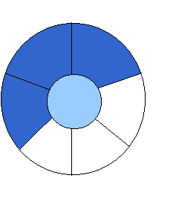
Solution: A Circular Queue
[2]
[3] [2] [3]
J2
J3
[1]
J1
[4]
[4]
[1]
[0] [5] [0] [5]
front = 0 front = 0
rear = 0 rear = 3
Can be seen as a circular queue

Slide 19

Solution: A Circular Queue
FULL QUEUE FULL QUEUE
[2] [3] [2] [3]
J2 J3
J8 J9
[1] [4] [1] [4]
J1 J4
J7
J5
J6 J5
[0] [5] [0] [5]
front =0
rear = 5
front =4
rear =3

Slide 20
Priority Queue
There are two types of Queues
  Max Priority Queue
  Min Priority Queue
  Implementation with an unsorted sequence
  Implementation with a sorted sequence
When Inserting an element Insert with the priority value.
For retrieval use either Max or Min Priority value.
key: An object that is assigned to an element as a specific attribute for that element, which can be used to identify, rank, or weight that element.

Slide 21
Max Priority Queue
Collection of elements.
Each element has a priority or key.
Supports following operations:
  isEmpty
  size
  add/put an element into the priority queue
  get element with max priority
  remove element with max priority

Slide 22
Min Priority Queue
Collection of elements.
Each element has a priority or key.
Supports following operations:
  isEmpty
  size
  add/put an element into the priority queue
  get element with min priority
  remove element with min priority

Slide 23
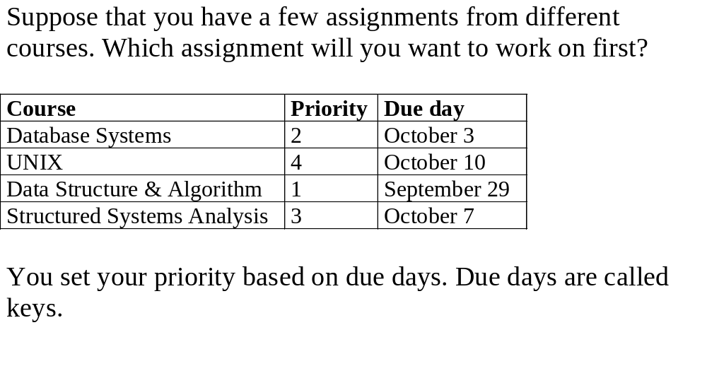
Determining The Key

Slide 24
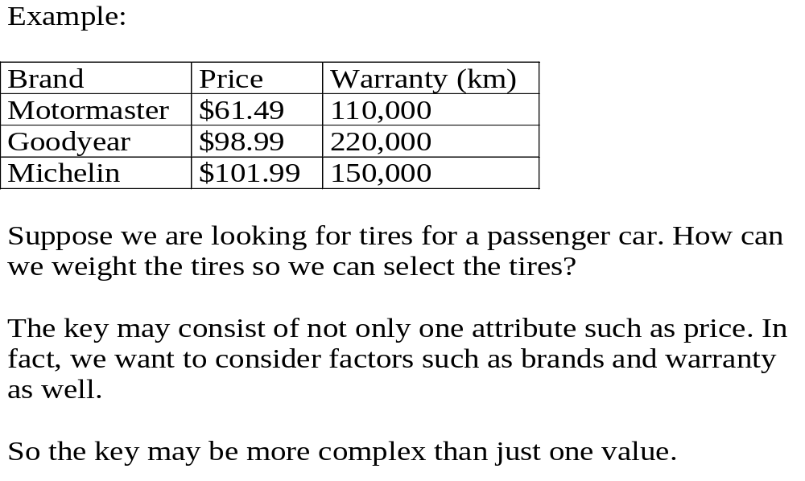
Determining the Key (Contd)‏

Slide 25
Implementation
priority queue: A container of elements, each having an associated key that is provided at the time the element is inserted.
The two fundamental operations of a priority queue
  insertItem(k,e):
    Insert an element e with key k into P.
  removeMin():
    Return and remove from P an element with the smallest key.
There are two ways to implement a priority queue with a sequence:
    Keys in the sequence are sorted.
    Keys in the sequence are not sorted.

Slide 26
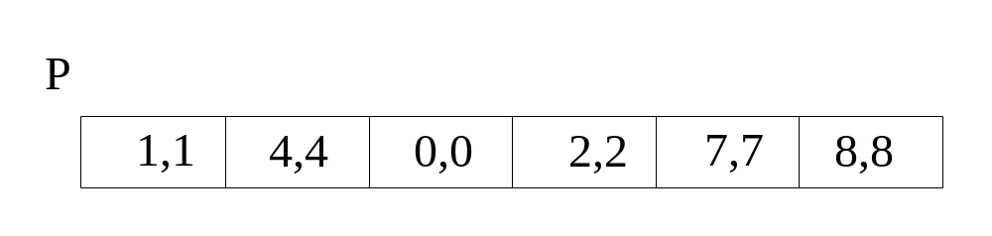
Implementation with an Unsorted Sequence
Let S be a sequence. A pair of key and element is denoted as p=(k,e). With an unsorted sequence, we use the method insertLast(p) of S to implement insertItem(k,e) of the priority queue P.
To perform operations including minElement, minKey, and removeMin, we have to inspect all the elements of the sequence S to find the element with the smallest key.

Slide 27
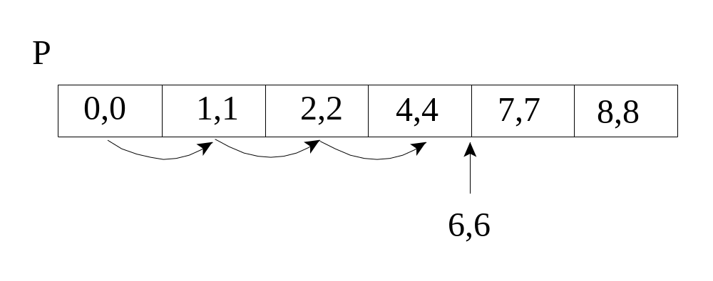
Implementation with an Sorted Sequence
Let S be a sequence. A pair of key and element is denoted as p=(k,e). With an sorted sequence, we can easily extract the element with the smallest key with the combination of methods remove() and first() of S.
However, to perform operation insertItem, we need to scan through the sequence S to find the apropriate position to insert the new element and key.

Slide 28
Application
Sorting
use element key as priority
put elements to be sorted into a priority queue
extract elements in priority order
  if a min priority queue is used, elements are extracted in ascending order of priority (or key)‏
  if a max priority queue is used, elements are extracted in descending order of priority (or key)‏

Slide 29
Sorting Example
Sort five elements whose keys are 6,8,
2, 4, 1 using a max priority queue.
  Put the five elements into a max priority queue.
  Do five remove max operations placing removed elements into the sorted array from right to left.

Slide 30
After Putting Into Max Priority Queue
8
4
6
Max Priority Queue
1
2
Sorted Array

Slide 31
After First Remove Max Operation
4
6
Max Priority Queue
1
2
8
Sorted Array

Slide 32
After Second Remove Max Operation
4
Max Priority Queue
1
2
6
8
Sorted Array

Slide 33
After Third Remove Max Operation
Max Priority Queue
1
2
4
6
8
Sorted Array

Slide 34
After Fourth Remove Max Operation
Max Priority Queue
1
2
4
6
8
Sorted Array

Slide 35
After Fifth Remove Max Operation
Max Priority Queue
1
2
4
6
8
Sorted Array

